Slide 1
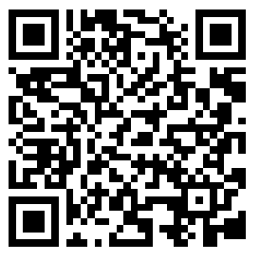
CS2113/T – Lecture 3
Go to* github.com/nus-cs2113-AY2021S2/contacts
Fork to your GitHub account
Clone the fork to your computer
Set up the project in IDE
You’ll be using this code to do an in-lecture submission later
Also, join the presentation http://pollev.com/anarayan
Archipelago session for QA
This lecture will be recorded
This lecture will be recorded
* Reused from previous semester lecture

Slide 2
Recap
RCS/Git
Code Quality
OOP

Slide 3

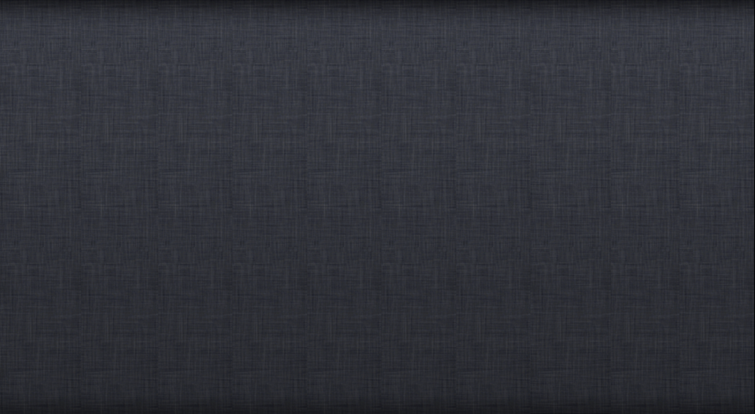
Let’s follow real world
OBJECT-ORIENTED
OBJECT-ORIENTED
Object [ Data + related functions]
Structure solution as collaborating objects.

Slide 4
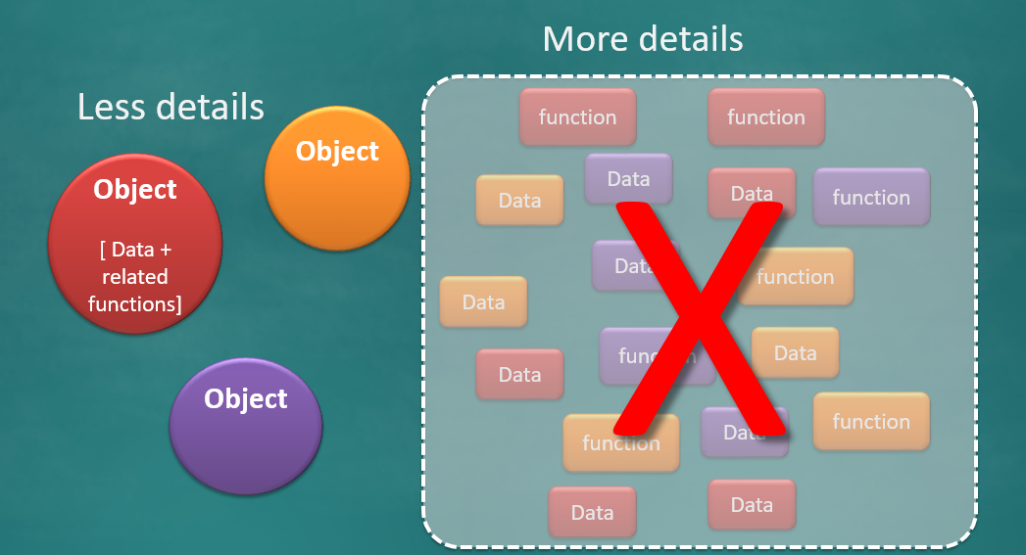
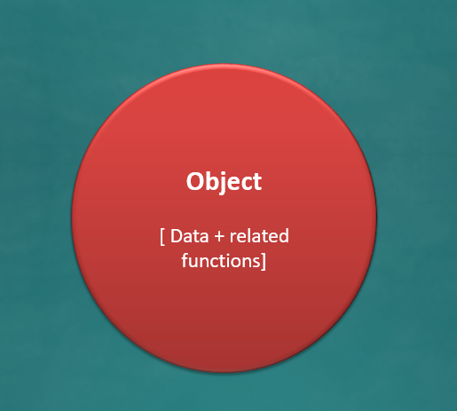
Abstraction
Encapsulates

Slide 5
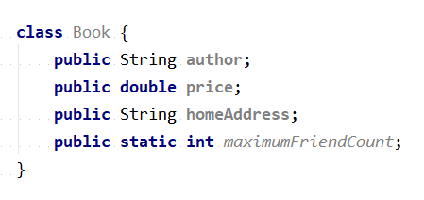
Which OOP aspect is weak in this class?
Abstraction
Encapsulation
Both

Slide 6
Activity: run Contacts0 class
Which values are accepted as valid phone numbers?
Try to find the same info in the Contacts1 class instead
Option 1: search for a method such as is…Phone…
Option 2: try to follow the program logic to locate where the phone number is validated
Go to github.com/nus-cs2113-AY2021S2/contacts
Fork to your GitHub account
Clone the fork to your computer
Set up the project in IDE

Slide 7
Activity: run Contacts0 class
Which values are accepted as valid phone numbers?
Try to find the same info in the Contacts1 class instead
Option 1: search for a method such as is…Phone…
Option 2: try to follow the program logic to locate where the phone number is validated
Q – Which of them is OOP?

Slide 8
How to make it OOP?

Slide 9
Admin matters

Slide 10
Practical Exam Dry Run – Rescheduled
Important!
PE – Dry run Week 12 lecture slot
But,
Week 12 lecture is on April 2, 2021 – Good Friday (PH)
Rescheduled to Saturday April 3, 2021 4 pm – 6 pm

Slide 11
iP - Questions
Do I need to tag everything? E.g., Level-X, A-xtnson etc.,
I missed tagging something earlier, can I tag now?
How will iP be graded?
If there are minor errors, can I correct it later?

Slide 12
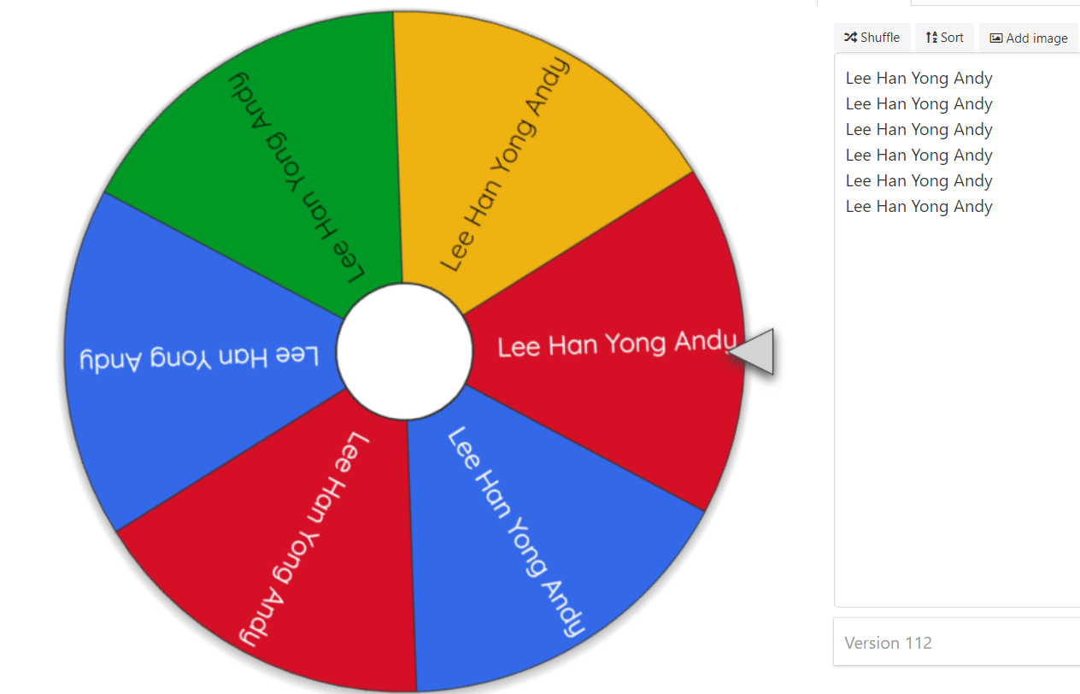
Spin the Wheel!

Slide 13
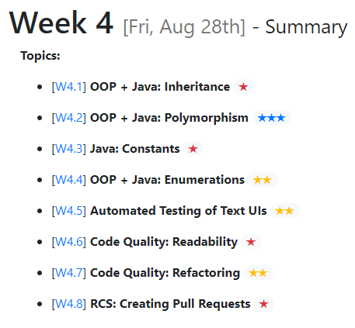

Slide 14
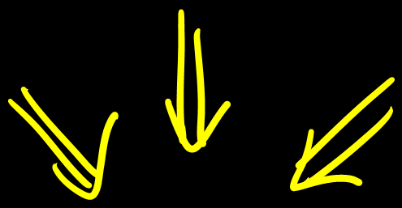

What should be the characteristics of good quality code?
Good code
Fast
Secure
Readable

Slide 15
How do you measure the quality of code?

Slide 16
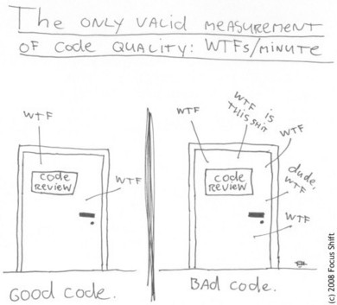
Good code, bad code:
Toward production quality code
Fast
Secure
______

Slide 17


*Your* code quality → Your project grade
[~8%, individual]
→ Your career

Slide 18
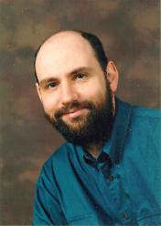
Any fool can write code that a computer can understand. Good programmers write code that humans can understand. --Martin Fowler

Slide 19
SUBJECTIVE
SUBJECTIVE
SUBJECTIVE
CONCRETE
SUBJECTIVE
SUBJECTIVE
CONCRETE
SUBJECTIVE
SUBJECTIVE
SUBJECTIVE
SUBJECTIVE
CONCRETE

Slide 20


Naming
ClassName
variableName
CONSTANT_NAME
doSomething()
doSomething_nothingToDo_throwsException()

Slide 21
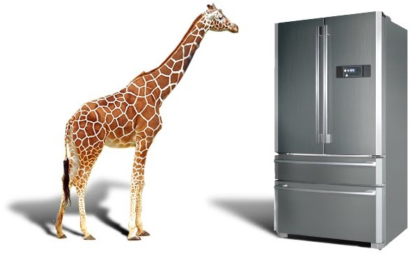
How do you put a giraffe in a fridge?

Slide 22
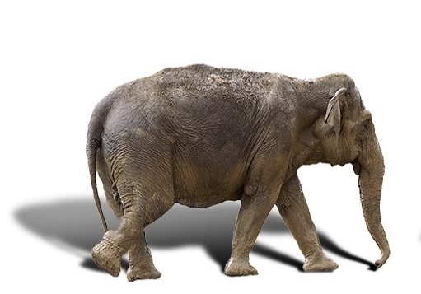
How do you put an elephant in a fridge?

Slide 23

How do you put an elephant in a fridge?

Slide 24

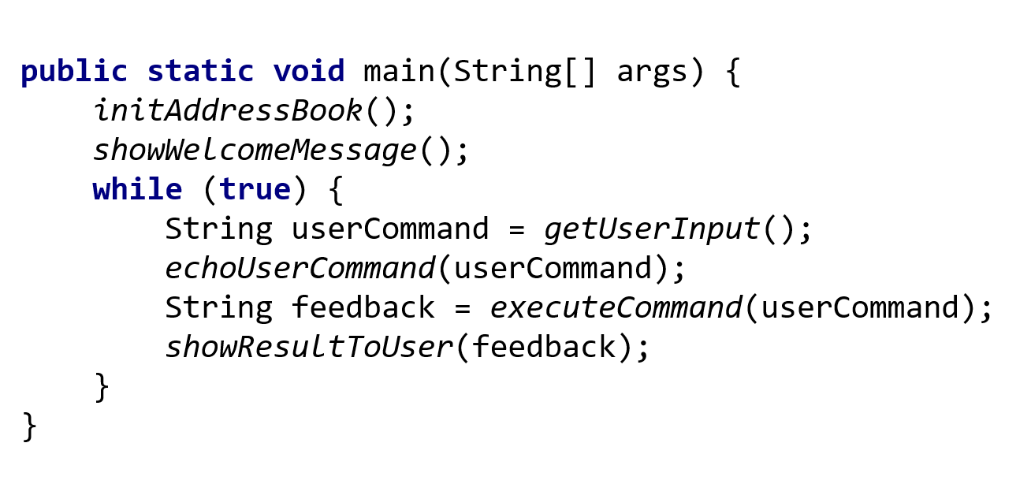
SLAP
[Single Level of Abstraction Per function]

Slide 25
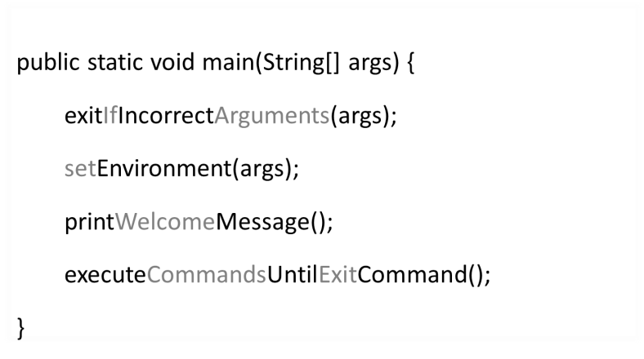
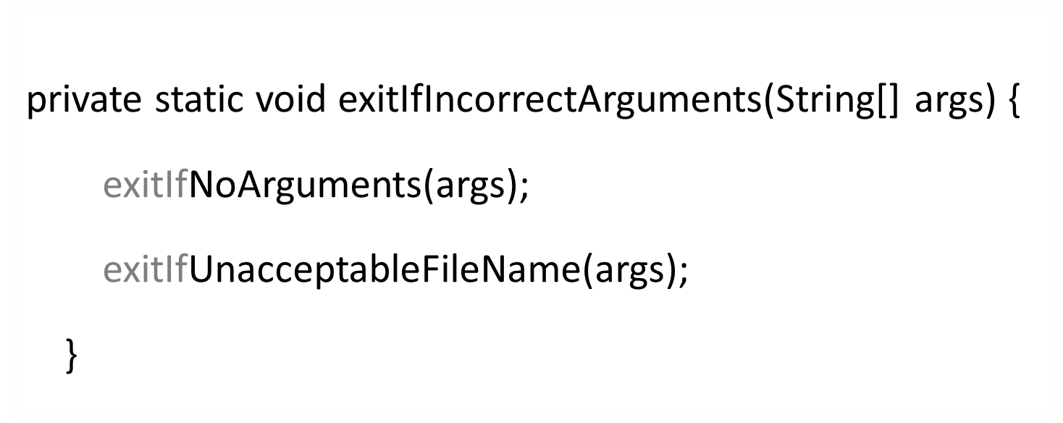
Let’s read CE1 of another guy
private static void exitIfIncorrectArguments(String[] args) {
exitIfNoArguments(args);
exitIfUnacceptableFileName(args);
}

Slide 26
Let’s read CE1 of another guy
private static void exitIfIncorrectArguments(String[] args) {
exitIfNoArguments(args);
exitIfUnacceptableFileName(args);
}

Slide 27
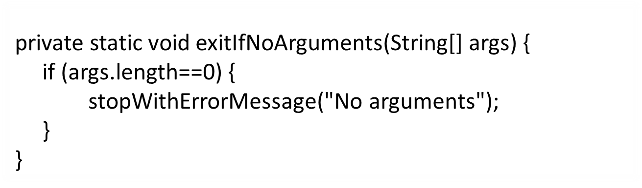
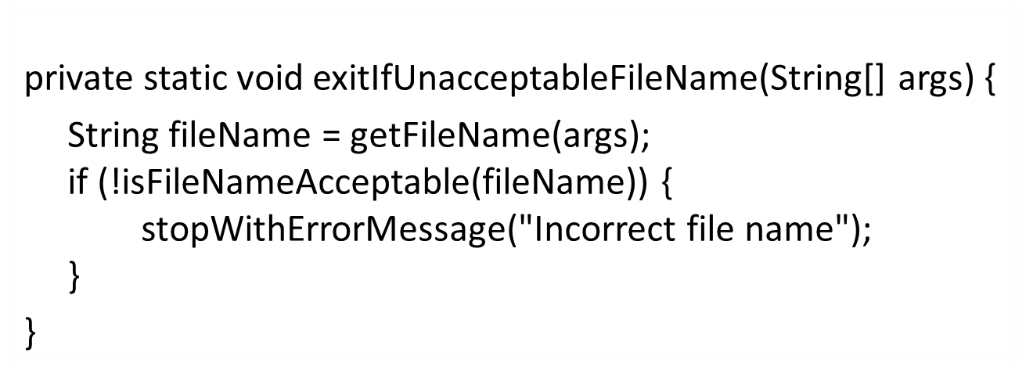
Let’s read CE1 of another guy
Levels of abstraction

Slide 28
SLAP (Single Level of Abstraction Per function)
No SLAP
public static void main(String[] args) { exitIfIncorrectArguments(args); setEnvironment(args); printWelcomeMessage(); executeCommandsUntilExitCommand();
}
public static void main(String[] args) { if (args.length == 0) { System.out.println("No arguments"); System.exit(0); } String fileName = args[0]; if (!isFileNameAcceptable(fileName)) { System.out.println("Incorrect file name!"); System.exit(0); } File f = new File(fileName); if (!f.exists()) { try { f.createNewFile(); } catch (IOException e) { System.out.println("Cannot create file!"); System.exit(0); } } System.out.println("Welcome. " + fileName + " is ready to use"); while (!isExitCommand) { System.out.print("Enter command:"); String command = scanner.nextLine(); command = readLineFromConsole(); if (isAddCommand(command)) { executeAddCommand(command); } else if (isDisplayCommand(command)) { executeDisplayCommand(command); } else if (isExitCommand(command)) { exectueExitCommand(command); } } }
public static void main(String[] args) {
exitIfIncorrectArguments(args);
File f = new File(fileName); if (!f.exists()) { try { f.createNewFile(); } catch (IOException e) { System.out.println( "Cannot create file!"); System.exit(0); } }
printWelcomeMessage();
executeCommandsUntilExitCommand();
}
private static void exitIfIncorrectArguments(String[] args) {
exitIfNoArguments(args); exitIfUnacceptableFileName(args);
}
private static void exitIfNoArguments(String[] args) { if (args.length==0) {
stopWithErrorMessage("No arguments"); }
}
private static void stopWithErrorMessage(String message) {
System.out.println(message);
System.exit(0);
}

Slide 29
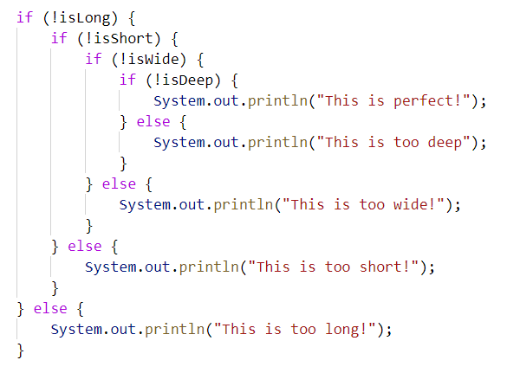
Avoid
Deep nesting
✘

Slide 30
int calculateDiscount(){
int subsidy;
if (isSenior) {
subsidy = -1 } else if (isAlreadySubsidized) {
subsidy = 250 ;
} else if (isPartTime)
subsidy = 250 ;
} else { subsidy = 500;
}
return subsidy;
}
Can write this instead:
if (isAlreadySubsidized || isPartTime)
250
MAGIC LITERALS

Slide 31
final int SUBSIDY_FULLTIME = 500
Avoid
Magic literals
int calculateDiscount(){
int subsidy;
if (isSenior) {
subsidy = REJECT_SENIOR; } else if (isAlreadySubsidized) {
subsidy = SUBSIDY_FULLTIME * RATIO_SUBSIDIZED;
} else if (isPartTime)
subsidy = SUBSIDY_FULLTIME * RATIO_PARTTIME ;
} else { subsidy = SUBSIDY_FULLTIME;
}
return subsidy;
}

Slide 32
Activity: Improve Code
Extract method
Replace magic number
Rename variable

Slide 33
Refactoring
REFACTORING
REFACTORING
[Improving structure incrementally without modifying behaviour]

Slide 34
Refactoring
REFACTORING
[Improving structure incrementally without modifying behaviour]
Bug fixing?
Rewriting?

Slide 35
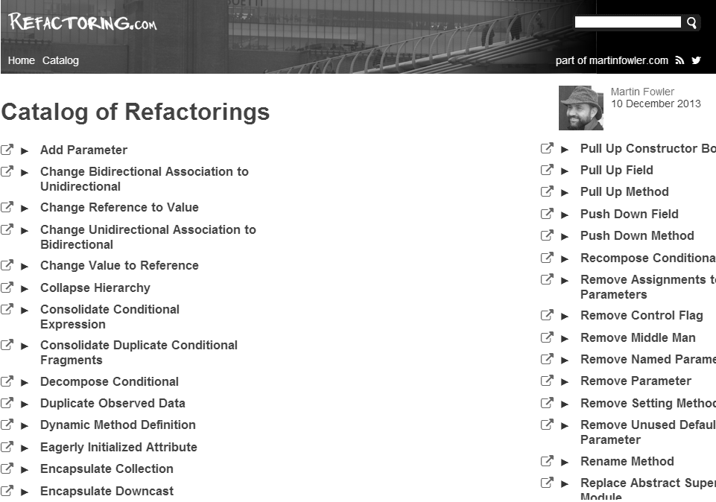
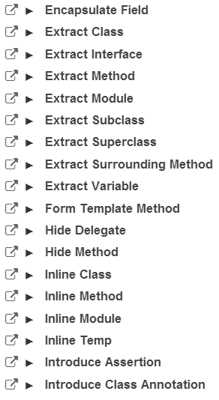
Catalog
Martin Fowler
memorize

Slide 36
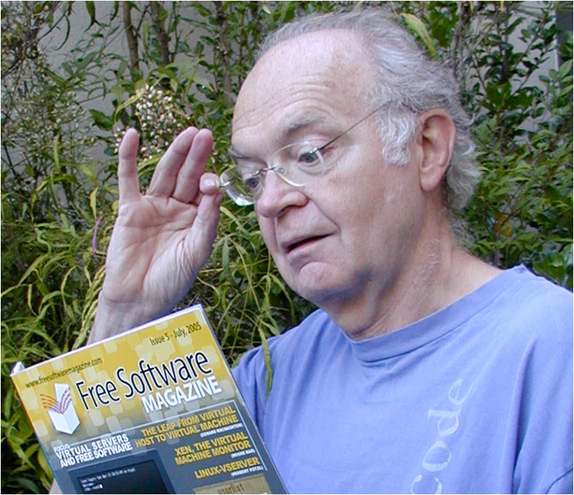
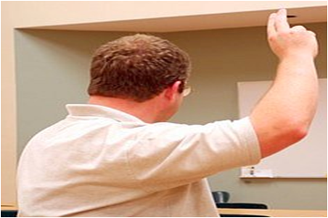
Avoid
Premature optimization is the root of all evil in programming.
--Donald Knuth
The code is inefficient

Slide 37

Make it work, right, fast
code
Lesson: Me sy things get m r
Code:
Make it work
Make it right
Make it fast

Slide 38

Make it work, right, fast
code
Lesson: Me sy things get m r
REFACTORING
Make it work
Make it right
Make it fast

Slide 39
✔
✔

Slide 40

Bug fix → break other code?
REGRESSIONS
[undesirable side effects of modifications]

Slide 41
Activity: Automated CLI Tests
Run text-UI tests
Modify behavior while updating tests

Slide 42
✔
✔
✔

Slide 43

Pull Request (PR)
Repo on remote server
Forked repo on GitHub
GitHub
fork
push
pull
push
clone
Local repo
Local repo
init
commit
Duke dev
You

Slide 44
Activity: Create Pull Request
Commit some changes to the contacts repo
Push to the fork
Create a pull request
Review a peer PR in the contacts repo

Slide 45
✔
✔
✔
✔

Slide 46
Four OOP fundamental concepts:
Abstraction
Encapsulation
Inheritance
Polymorphism

Slide 47
Inheritance
specialization
generalization
superclass : subclass
parent class : child class
base class : derived/extended class
Student
Person
Teacher
AdminStaff
is a

Slide 48
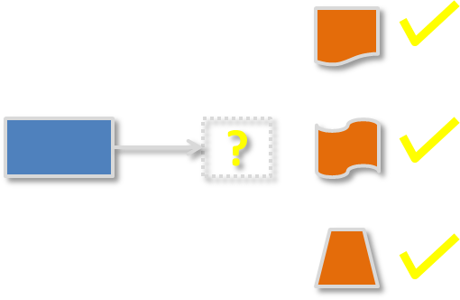
Polymorphism
Ability to treat different types as same type and yet get different behavior
Ability to be accepted as a different type but maintain own behavior

Slide 49

My students can be only UG, PG, EXCHG
public enum StudentType {
UG, PG,
EXCHG
}
StudentType.UG;
Use a variable lor
Enumerations

Slide 50
✔
✔
✔
✔
✔
✔
✔
✔

